Slide 1
Structural Reconstruction of a ruined building
Project team: P-03
Team members: Anshul Aggarwal A0191501R
Gogula Krishnan Saravanan A0191385X
Manasa Kashyap A0178462W
Meenakshi Sundaram Viswanathan A0191324L

Slide 2
Introduction
Ruins are the remains of a man-made building
Buildings might be ruined overtime due to:
Lack of maintenance
Acts of destruction
Natural disaster
Weathering.
Aim : Reconstruct the defining structure of any ruined building efficiently by employing data/model fitting techniques.

Slide 3
Applications
Reconstruction of ruins of ancient building will help historians and archaeologists to better understand civilisation and style of architecture.
Structural Engineers could use the reconstructed model to better study the building and type of repairs required

Slide 4
Problem definition
Objective: Obtain surface functions of the building in order to recreate the model of the building
Inputs:
Point cloud , S= {p₁,p₂…..,p_{n}} where p_{i} = (x_{i},y_{i},z_{i}) , i= 1,2…..n
Number of surfaces k
Centroids of each surface c_{j}, j = 1,2…..k

Slide 5
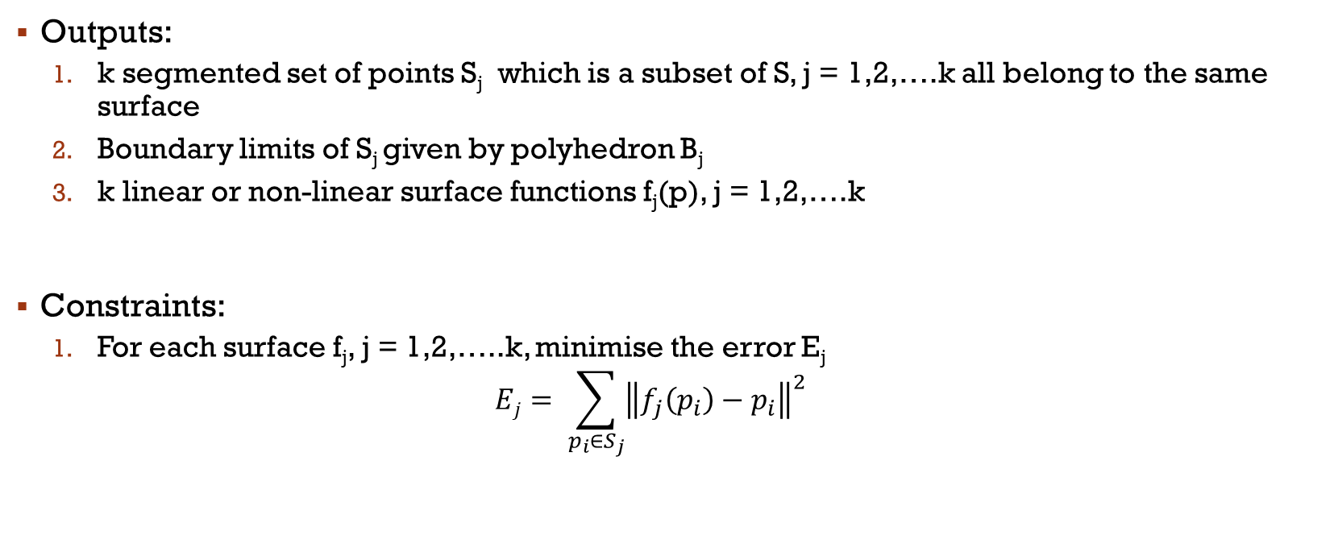
Problem definition
Outputs:
k segmented set of points S_{j} which is a subset of S, j = 1,2,….k all belong to the same surface
Boundary limits of S_{j} given by polyhedron B_{j}
k linear or non-linear surface functions f_{j}(p), j = 1,2,….k
Constraints:
For each surface f_{j}, j = 1,2,…..k, minimise the error E_{j}
$$Ej= \sum_{p_{i}∈S_{j}}{{\left\|f_{j}\left(p_{i}\right)−p_{i}\right\|}^{2}}$$

Slide 6
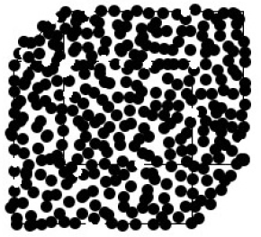
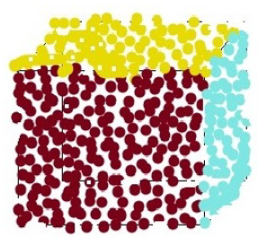
Algorithm
Point Cloud Segmentation
Divide Point Cloud into point sets
Each set contains points belonging to the same surface
Uses a modified region growing algorithm.

Slide 7
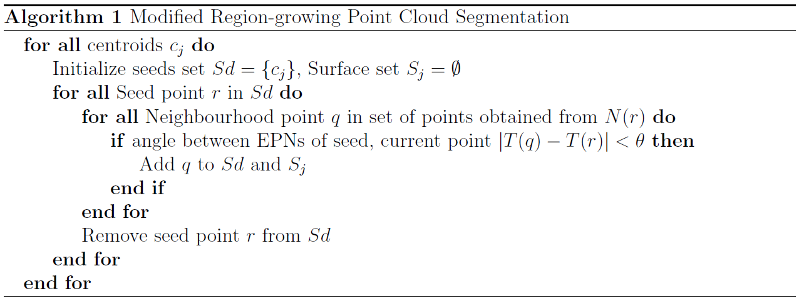

Slide 8
Algorithm
Piecewise Robust Polynomial Fitting
Piecewise polynomial fitting
Fit surfaces over smaller neighbourhoods
Remove outliers in the process, that affect the quality of the fitting.

Slide 9
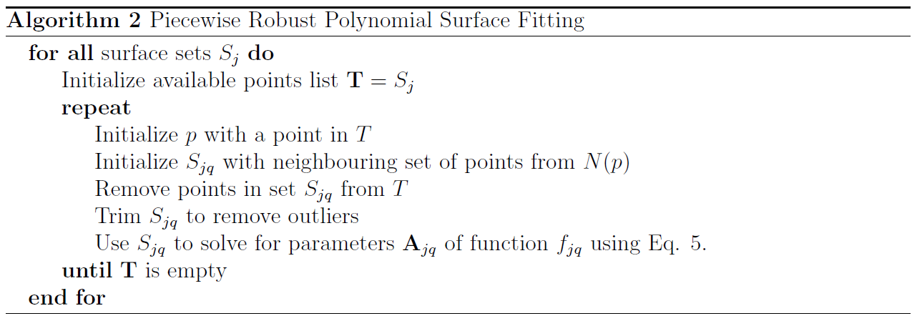

Slide 10
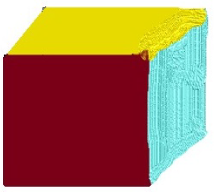
Algorithm
Reconstruction
Find surface bounds
Recreate a dense point cloud, with missing features reconstructed

Slide 11
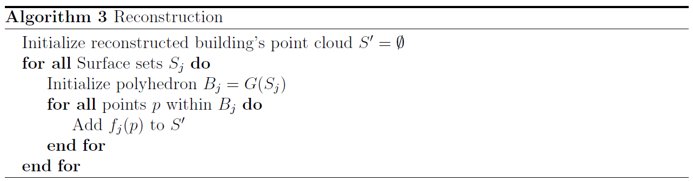

Slide 12
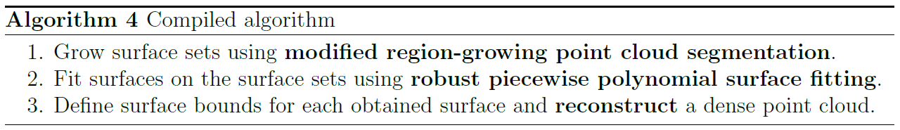
Compiled Algorithm

Slide 13
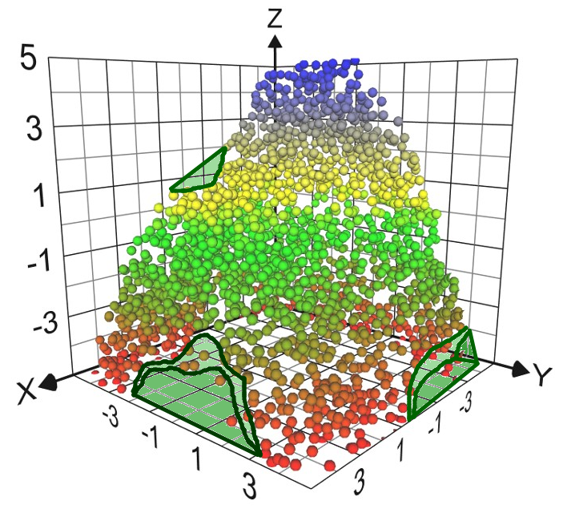
Problem Instances
Regions that have zero point density might be difficult to represent in computational terms
We used data fitting to obtain surfaces that give the best fit
The missing points are recovered by the points on the obtained surfaces

Slide 14
Issues
A part of the building where there is complete loss of information cannot be reconstructed
For example, if an asymmetric corner of the building is completely lost, it is not possible to reconstruct it and therefore, the reconstructed model of the ruin might not be an accurate representation.
Extent of damage matters.

Slide 15
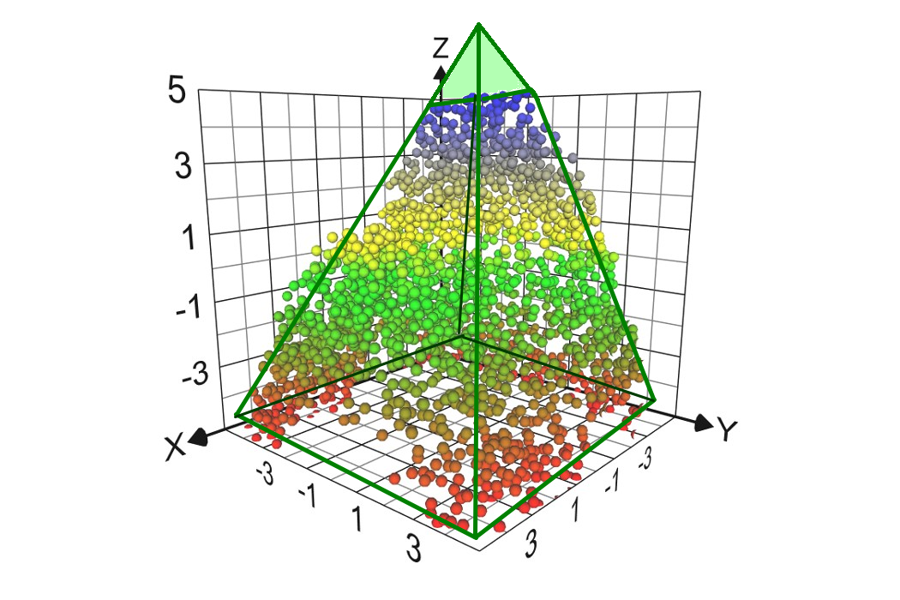
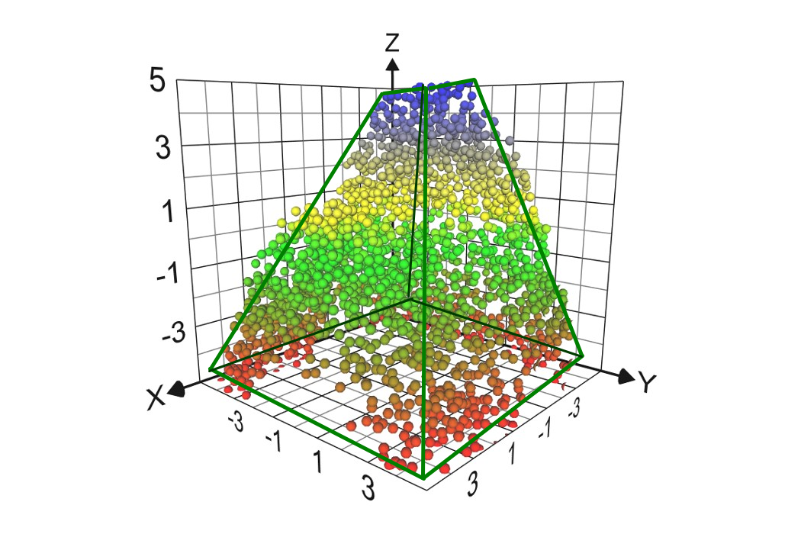

Slide 16
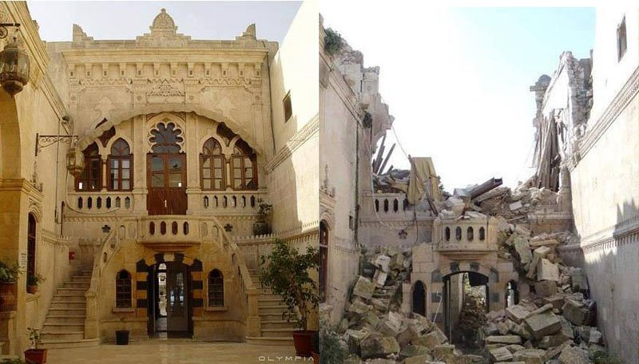
Difficult to get a good reconstruction in such cases
Image: Syrian Civil War, 2015

Slide 17
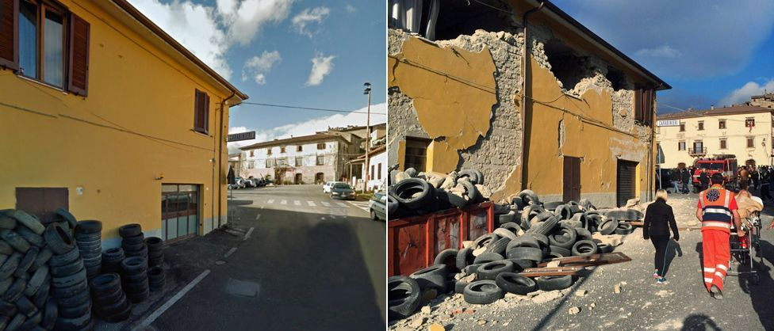
Easier to reconstruct
Image: Italy earthquake, August 2016

Slide 18
conclusion
Reconstructed models for damaged or ruined buildings.
Three step process.
Reconstruction quality depends on the extent of damage.

